Slide 1

Review 1.2
B. Tech. Project (19ECE495)
Batch ID: 070
Mutual coupling reduction in MIMO Patch Antenna Array for Wi-Fi and Bluetooth applications
MENTOR: : Ms. V. MEKALA DEVI
Dept. of Elec. and Commn. Engg.
Amrita School of Engineering, Coimbatore
CB.EN.U4ECE22225 | - | J Rohith
CB.EN.U4ECE22262 | - | Peddakudala Yashwanth
CB.EN.U4ECE22213 | - | Chundupalle Tej Siddanth

Slide 2
Summary :
1.Project Focus: Design and implementation of a compact MIMO patch antenna array at 2.4 GHz with decoupling structures for Wi-Fi and Bluetooth applications, aiming for high isolation (>20 dB) and element spacing < λ/2..
2. Motivation:
Rising demand for MIMO systems in IoT, 5G, and smart devices.
3.Problem and objective:
Problem: Mutual coupling between closely spaced MIMO antenna elements reduces efficiency, gain, and matching.
Objective: Design, analyse, and prototype a patch antenna array with effective decoupling to enhance isolation while maintaining compactness at 2.4 GHz.

Slide 3
TIMELINE:
Review | Month | Milestone
1.1 | June-July 2025 | Literature survey for decoupling structures
1.2 | August – September 2025 | Design and analysis of base antenna at 2.4 GHz.
1.3 | October-November 2025 | Design and analysis of a Patch antenna array at 2.4 GHz
2.1 | December 2025-January 2026 | Design and analysis of a Patch antenna array with decoupling structures at 2.4 GHz.
2.2 | February-March 2026 | Prototype and Measurement

Slide 4
LITERATURE:
Sl. # | Title of the paper | Source | Inferences
1 | Compact Self-Isolated Four-Element MIMO Antenna for WLAN and ISM Bands Application | IEEE Antennas and Wireless Propagation Letters, 2023 | Key Advantage of Proposed Work Self-isolation (no extra structures). Most compact (40 × 40 mm²) among compared works. Highest isolation (>20 dB) and lowest ECC (<0.02). Very good for portable WLAN/ISM devices. Limitations Single-band (2.4 GHz) only. Lower gain (~2.8 dBi) compared to some dual/tri-band designs.
2 | Decoupling Between Extremely Closely Spaced Patch Antennas by Mode Cancellation Method | IEEE Antennas and Wireless Propagation Letters, 2024 | Key Advantage of Proposed Work Isolation: 5 dB → 15.4 dB+ (2.39–2.53 GHz). Better radiation: Gain 7.8 dBi, FBR 25 dB, low x-pol. High efficiency (82–87%), ECC < 0.004. Works for 1-D & 2-D arrays, simple + tiny size. Limitations Only good for very strong coupling (tiny gaps). Weak coupling → poor effect. Bandwidth small (~5%) unless modified.

Slide 5
LITERATURE
Sl. # | Title of the paper | Source | Inferences
3 | Mutual Coupling Reduction of a Dual-Band Four-Port Patch Antenna With Co-Polarized Radiation Pattern by Controlling Electric Fields | IEEE Transactions on Antennas and Propagation, 2023 | Key Advantage of Proposed Work First dual-band, four-port, co-polarized patch antenna with low MC (< –15 dB) and single radiator. Compact + no extra feeding network. Limitations More design complexity (multiple pins + slots). Upper-band initially had non-broadside beam (fixed using pin 4). Bandwidth moderate compared to some wideband arrays.
4 | A Compact Multifrequency Broadband Dual-Antenna System With Mutual Coupling Reduction for Wi-Fi 6E Application | IEEE Transactions on Antennas and Wireless Propagation, 2024. | Key Advantage of Proposed Work Most compact design (shortest length). Achieves highest isolation (>22 dB). Covers all Wi-Fi bands including 6E (2.4 / 5 / 6–7 GHz). Maintains low ECC (<0.3) → better MIMO performance. Limitations Efficiency (40–50%) lower than some larger designs. Only dual-antenna system (not 4×4/8×8 scalable).

Slide 6
LITERATURE:
Sl. # | Title of the paper | Source | Inferences
5 | Mutual Coupling Reduction in Dual-Band MIMO Antenna Using Parasitic Dollar-Shaped Structure for Modern Wireless Communication | IEEE Transactions on Antennas and Propagation, September 2023 | Key Advantage of Proposed Work Highest isolation (>30 dB) among compared designs. Lowest ECC (<0.02) → excellent diversity. Simple parasitic structure, compact design. Performance: Operating bands: 3.5 GHz (5G) and 5.2 GHz (WLAN). Isolation improved to >30 dB (without needing complex decoupling networks). Limitations Only dual-band (3.5 & 5.2 GHz). 2-element system (not tested for 4-port or higher). Moderate gain (~3.5 dBi) compared to some multi-port systems.

Slide 7
Methodology:
Designing a Rectngular a Patch Antenna using HFSS
Analysis of S Parameter , Gain plots for an element with HFSS
Design of 1×2 MIMO Array without Decoupling Structure
Experimental Validation of final results and Documentation
Fabrication of Optimized Design
Insertion of Decoupling Structure and Performance Analysis (Isolation,Gain)
28-08-2025
7

Slide 8
1) Designing a Microstrip Patch Antenna using HFSS
Antenna Dimension Calculation:
As the frequency of the application is 2.4GHz , considering Rogers RT duroid 5880 (εr = 2.2) as the suitable
substrate, the basic patch antenna dimensions are calculated below.
Ground Plane and Substrate Design:
Ensure the ground plane is at least 6 times the substrate height larger than the patch to provide optimal radiation efficiency and minimize fringing effects.
Simulation Setup in HFSS:
Define the boundary conditions for the patch and ground plane using "Perfect E" boundaries.
Assign a radiation boundary to a box surrounding the antenna, positioned at least λ/4 away from the structure to simulate the radiation in a free space environment.
Apply the appropriate excitation, such as a Wave Port/Lumped Port.

Slide 9
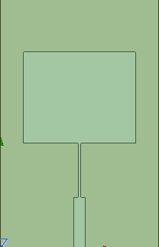







Patch Antenna Dimension Calculation:
As the frequency of the application is 2.4 GHz, considering Rogers RT duroid 5880 (εr = 2.2) is a suitable substrate, the basic patch antenna dimensions are determined through mathematical calculations.
Designed for 2.4 GHz rectangular patch on Rogers RT duroid 5880(εr = 2.2) with h = 1.6 mm.
Determining Path Widh(W) an Length(L)
Width
Effective Permittivity εeff​
Fringing extension ΔL
W= 49.38 mm
Fig: Simulated model of unit element of an Array
εeff≈2.03

Slide 10





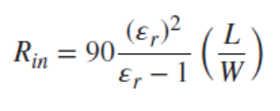

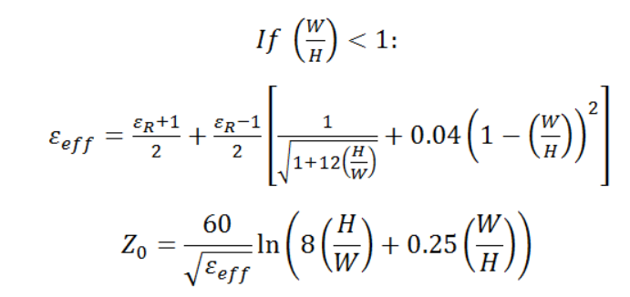
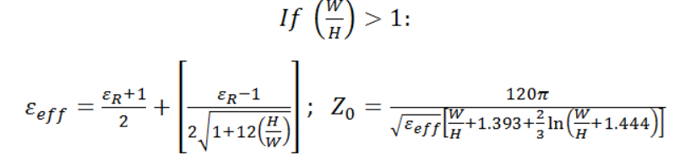
Impedance Matching:
Here, the length is λ/4 and the width can be calculated as follows:

Slide 11
Methodology:
Designing an Element Microstrip Patch Antenna using HFSS
Analysis of S Parameter , Gain plots for an element with HFSS
Design of 1×2 MIMO Array without Decoupling Structure
Experimental Validation of final results and Documentation
Fabrication of Optimized Design
Insertion of DecouplingStructure and
Performance
Analysis(Isolation,Gain)
11

Slide 12
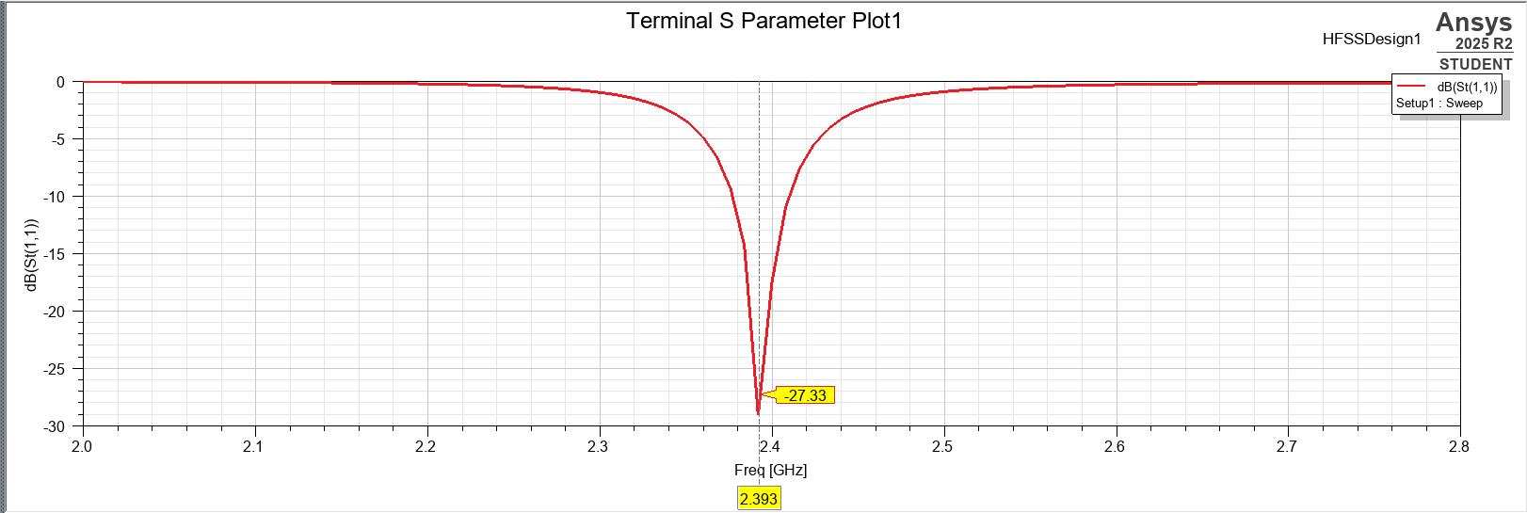
Analysis of Patch Antenna with HFSS
Performance Evaluation: Simulate the design to obtain the key performance metrics, such as
S-parameters (S11)
Radiation pattern
Impedance characteristics
Gain
Efficiency; to optimize antenna performance for the desired application.
Fig: Obtained S(1,1) Plot

Slide 13
Results
Parameter | Unit Element
S(1,1) Parameter | -27.33dB
Gain | 4.42dB
Impedance Matching | 50.2Ω

Slide 14
Deliverables:
Design and simulation of a unit element at 2.4 GHz rectangular patch antenna using substrate (εr = 2.2).
Analysis of S-parameters, impedance matching, and radiation characteristics of the antenna element
28-08-2025
Review 1.2
14

Slide 15
REFERENCES:
[1] G. Yang, Y. Zhang, and S. Zhang, “Compact Self-Isolated Four-Element MIMO Antenna for WLAN and ISM Bands Application ,” IEEE Open J. Antennas Propag., vol. 2, pp. 203–213, 2023, doi: 10.1109/OJAP.2023.3057062.
[2] W.-L. Zhou, S.-W. Qu, M. Xia, and S. Yang, “Decoupling Between Extremely Closely Spaced Patch Antennas by Mode Cancellation Method ,” IEEE Trans. Antennas Propag., vol. 70, no. 11, pp. 10475–10484, Nov. 2024, doi: 10.1109/TAP.2024.3195454.
[3] A. Li, S.-W. Qu, and S. Yang, “ Mutual Coupling Reduction of a Dual-Band Four-Port Patch Antenna With Co-Polarized Radiation Pattern by Controlling Electric Fields ,” IEEE Antennas Wireless Propag. Lett., vol. 21, no. 9, pp. 1762–1766, Sept. 2022, doi: 10.1109/LAWP.2022.3179404.
[4] Y. Yang, Y. Feng, L.-K. Zhang, Z. Xing, and J. Li, “ A Compact Multifrequency Broadband Dual-Antenna System With Mutual Coupling Reduction for Wi-Fi 6E Application ,” IEEE Antennas Wireless Propag. Lett., vol. 23, no. 12, pp. 4074–4078, Dec. 2024, doi: 10.1109/LAWP.2024.3428515.
[5] Z.-L. Su, K. W. Leung, and K. Lu, “Mutual Coupling Reduction in Dual-Band MIMO Antenna Using Parasitic Dollar-Shaped Structure for Modern Wireless Communication,” IEEE Trans. Antennas Propag., vol. 70, no. 9, pp. 7659–7669, Sept. 2023, doi: 10.1109/TAP.2023.3199567.

Slide 16
Thank You
28-08-2025
Review 1.2
16

